Slide 1

Modular Solar Array Cleaner
By TIM Robotics

Slide 2
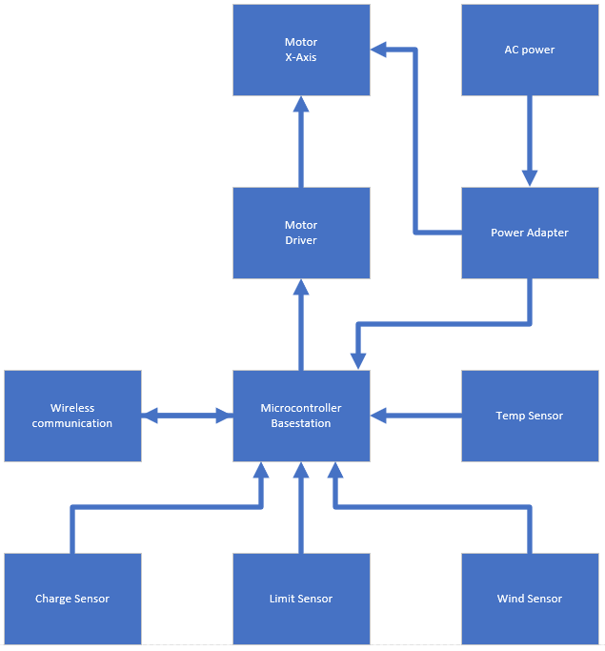
Basestation Block Diagram

Slide 3
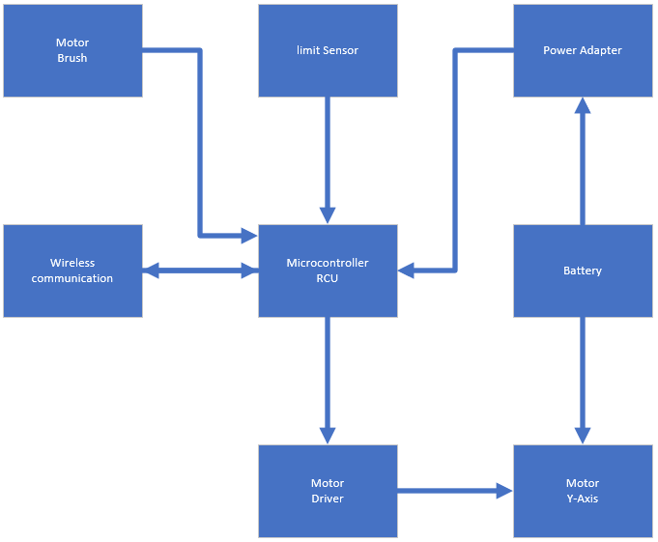
RCU Block Diagram

Slide 4
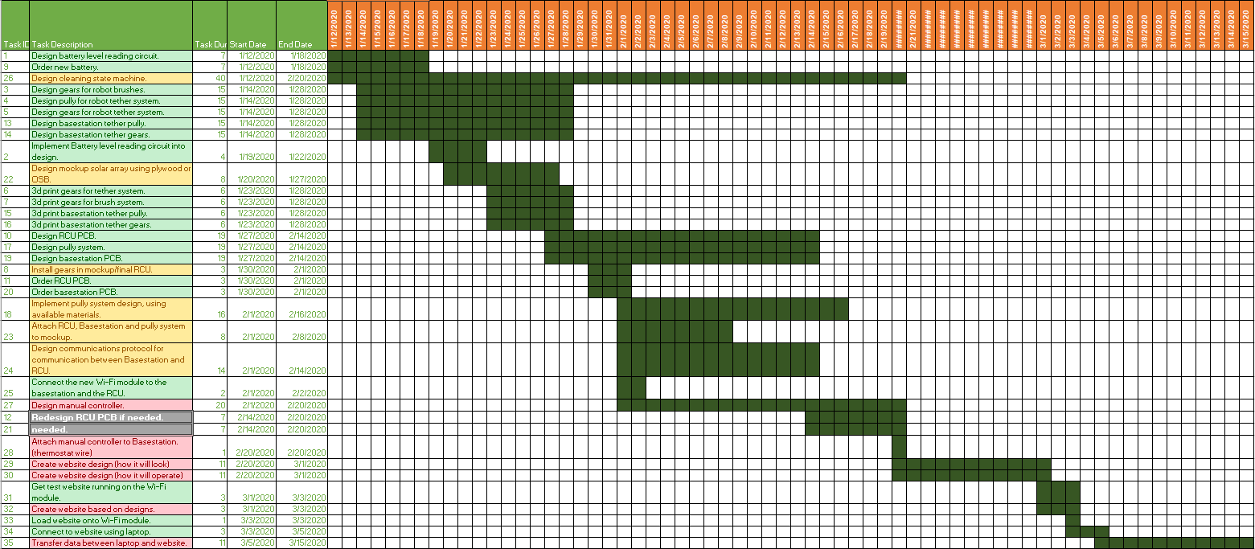
Progress

Slide 5
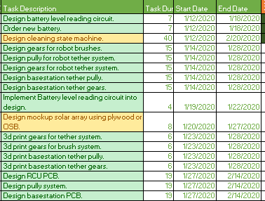
Progress

Slide 6
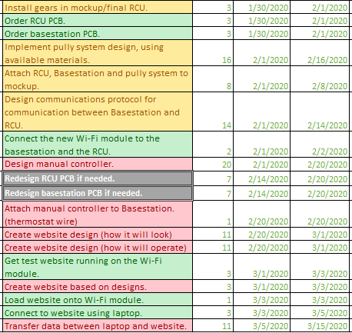
Progress

Slide 7
Project Changes
Removed Android requirement. Replaced with website requirement
Swapped to using WIFI communication instead of radio
Changed how manual controller will be implemented
It will now be a physical controller instead of an android app

Slide 8
Key System Features
The system is made up of two distinct part
The Basestation
The Robotic Cleaning Unit(RCU)
They will communicate wirelessly
A cleaning schedule can be set by the user
The user can also control the RCU manually
The RCU will charge its battery when docked at the Basestation
If the RCU battery runs low in the middle of a cleaning it will dock, charge and continue cleaning where it stopped

Slide 9
Software Items Currently implemented
Free RTOS functions(built in with freeRTOS, this OS runs all other functions)
Function to read analog sensors(temperature, wind)
Function to read digital sensors(switches, buttons)
Functions to use a button on the website
Function to send the website to a client

Slide 10
Software Items that need to be implemented
Double check previous functions used to read analog and digital sensors and make sure they work on the new microcontroller (they are the same family so they should)
Cleaning state machine(this will take care of manual and automatic)
Communication function(send and receive)
Scheduling functions(set and read)

Slide 11
ADC Initialization Code
void ADCInitialize(int ADC)
{
afec_enable(AFEC0);
afec_get_config_defaults(&afec_cfg);
afec_init(AFEC0, &afec_cfg);
afec_ch_get_config_defaults(&afec_ch_cfg);
afec_ch_set_config(AFEC0, AFEC_CHANNEL_0, &afec_ch_cfg);
afec_set_trigger(AFEC0, AFEC_TRIG_SW);
afec_channel_set_analog_offset(AFEC0,AFEC_CHANNEL_0,0x800);
afec_channel_set_analog_offset(AFEC0,AFEC_CHANNEL_6,0x800);
afec_channel_enable(AFEC0, AFEC_CHANNEL_0);
afec_channel_enable(AFEC0, AFEC_CHANNEL_6);
afec_set_callback(AFEC0, AFEC_INTERRUPT_DATA_READY, callback, 1);
afec_start_software_conversion(AFEC0);
}

Slide 12
ADC Read Code
void ADCGetValue(int ADC)
{
afec_start_software_conversion(AFEC0);
}
void callback()
{
afec_get_latest_value(AFEC0);
_ADC1Value = afec_channel_get_value(AFEC0, AFEC_CHANNEL_0);
_ADC2Value = afec_channel_get_value(AFEC0, AFEC_CHANNEL_6);
//tempeture calculations
tempc = ((_ADC1Value * 3300.0 / 4095.0) - 500.0) / 10.0;
tempf = (tempc * 9.0 / 5.0) + 32.0;
//windspeed calculations 0.4v-2v 0mps - 50mps
windmps = (((_ADC2Value * 3300.0 / 4095.0) - 400) / 1600) * 50;
printf("Temperature Celsius: %4d Fahrenheit: %4d Wind Speed in Mps: %4d\r", (int)tempc, (int)tempf, (int)windmps);
}

Slide 13
Button Initialization Code
void initializeBTNDriver(void)
{
ioport_set_pin_dir(BUTTON_1_PIN,IOPORT_DIR_INPUT);
ioport_set_pin_dir(BUTTON_2_PIN,IOPORT_DIR_INPUT);
ioport_set_pin_sense_mode(BUTTON_1_PIN, IOPORT_SENSE_RISING);
ioport_set_pin_sense_mode(BUTTON_2_PIN, IOPORT_SENSE_RISING);
ioport_set_pin_mode(BUTTON_1_PIN, IOPORT_MODE_PULLUP | IOPORT_MODE_DEBOUNCE);
ioport_set_pin_mode(BUTTON_2_PIN, IOPORT_MODE_PULLUP | IOPORT_MODE_DEBOUNCE);
}

Slide 14
Button Read Code
uint8_t readBTN(uint8_t uibtnNum)
{
switch(uibtnNum)
{
case 1:
{
return ioport_get_pin_level(BUTTON_1_PIN);
}
case 2:
{
return ioport_get_pin_level(BUTTON_2_PIN);
}
}
return 0;
}

Slide 15
Test Website Code
void setup() {
Serial.begin(115200);
pinMode(LED1pin, OUTPUT);
WiFi.softAP(ssid, password);
WiFi.softAPConfig(local_ip, gateway, subnet);
delay(100);
server.on("/", handle_OnConnect);
server.on("/led1on", handle_led1on);
server.on("/led1off", handle_led1off);
server.onNotFound(handle_NotFound);
server.begin();
Serial.println("HTTP server started");
}
void handle_OnConnect() {
LED1status = LOW;
Serial.println("GPIO7 Status: OFF");
server.send(200, "text/html", SendHTML(LED1status));
}
void handle_led1on() {
LED1status = HIGH;
Serial.println("GPIO7 Status: ON");
server.send(200, "text/html", SendHTML(true));
}
void handle_led1off() {
LED1status = LOW;
Serial.println("GPIO7 Status: OFF");
server.send(200, "text/html", SendHTML(false));
}
void handle_NotFound(){
server.send(404, "text/plain", "Not found");
}
String SendHTML(uint8_t led1stat){
String ptr = "<!DOCTYPE html> <html>\n";
if(led1stat)
{ptr +="<p>LED1 Status: ON</p><a class=\"button button-off\" href=\"/led1off\">OFF</a>\n";}
else
{ptr +="<p>LED1 Status: OFF</p><a class=\"button button-on\" href=\"/led1on\">ON</a>\n";}
ptr +="</body>\n";
ptr +="</html>\n";
return ptr;
}
void loop() {
server.handleClient();
if(LED1status)
{digitalWrite(LED1pin, HIGH);}
else
{digitalWrite(LED1pin, LOW);}
}

Slide 16
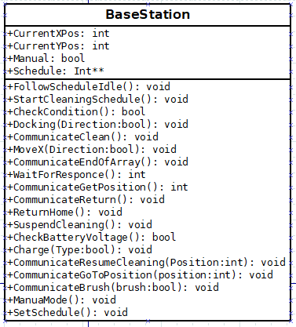
Basestation Software functions

Slide 17
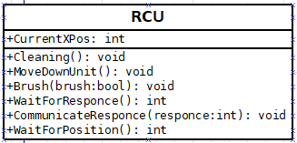
RCU Software Functions

Slide 18
Hardware Items Currently Implemented
3D Printed gears and pullies.
RCU and Basestation PCB design
Preliminary RCU and Basestation design
Pully System design
RCU brush layout
Microcontroller pinout
Component choice

Slide 19
Hardware Items That Need To Be Implemented
Integration of the PCB into the mockup(still on order)
Creation of the mockup solar array
Creation of the final mockup of the RCU and Basestation(will be made from particle board)
Creation of the final RCU and Basestation designs(made from aluminum)
Possibly upgrading the DC brush motor and adding in a ramp up circuit.(may have to swap to a PWM output to control motor if I cant find a circuit that will work)

Slide 20
Motors Chosen for MSAC
12v dc brushed motor (0.17A no load, 0.68A rated load, 2.19A stall)
100RPM
7kg/cm torque
Controlled by allowing power to pass through transistor
Using a resistor to limit current that might be pushed back to the board under failure conditions
12V, 1.7A, 667oz-in NEMA-17 Bipolar Stepper Motor
Controlled using a stepper driver board
Stepper driver board takes a PWM signal and steps one step per rising clock edge
Possibly will use a HKT22 Optical Encoder however to save cost we currently are not

Slide 21
Internal ADC
12 bit ADC
3.3v reference voltage
Currently measuring 0v to 2v(0v-1.7v temp, 0.4v-2v wind)
ADC usage = 2v/3.3v = ~60%
12 bit = 4096 steps
60% of 4096 = 2457
2457 > 2048
Updating and polling the ADC only when needed, using a software trigger
The TMP36 scales at 10mV/degree C, with the current ADC each step is equivalent to 0.8mV. Since we only want accuracy within 1 degree C this is more than 10 times the resolution needed
The resolution of the wind sensor is 0.1m/s. its range is 0.5m/s to 50m/s for a total of 495 possible output voltages that cover all wind speeds at the given resolution. Therefore since our ADC range of 0v-2v gives us 2457 steps then this is more then enough at about 5 times more steps than needed.
In conclusion even though we are not using the entire reference voltage it is still at least an 11 bit ADC for the voltages we are measuring. Doing this saves cost as to get to full resolution of the ADC we would need to step down 3.3v to 2v. This would add another part to the PCB and increase costs. On top of that there is no need to decrease the reference voltage to get more resolution as it would do nothing since the current resolution gives more steps then the possible outputs of the sensors

Slide 22
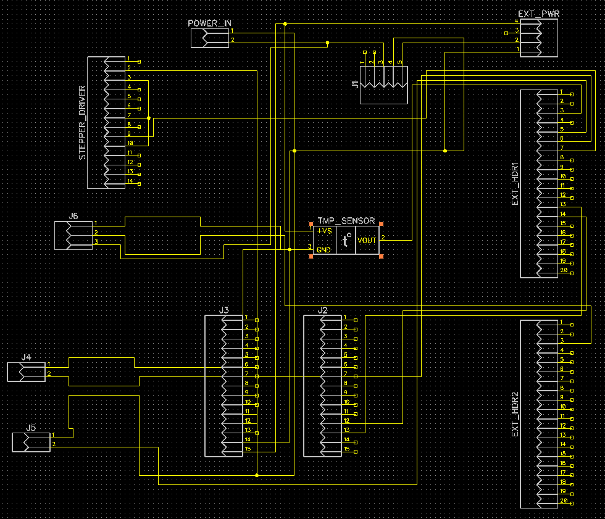
Basestaion PCB schematic

Slide 23
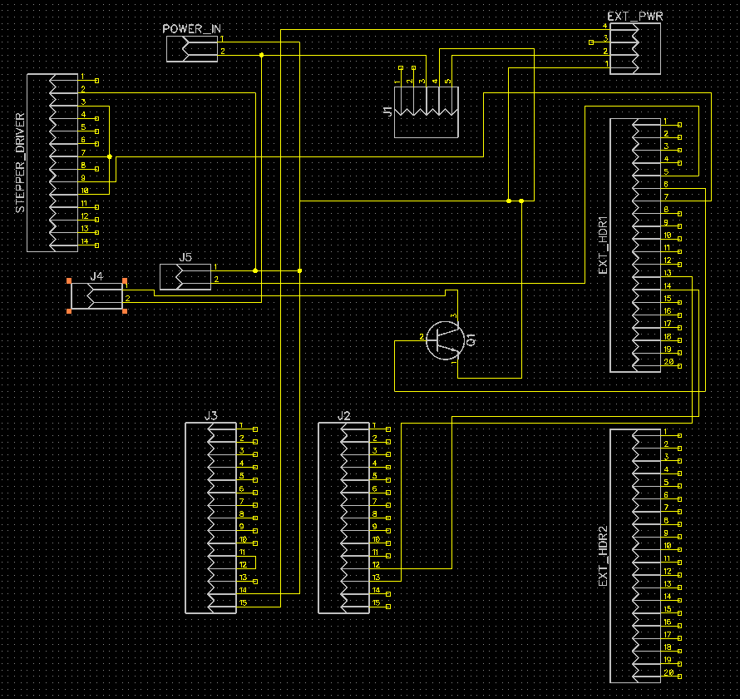
RCU PCB schematic

Slide 24
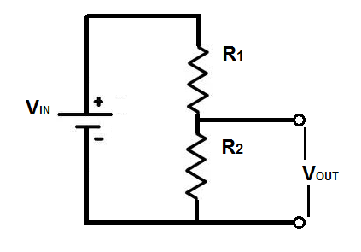
Battery Level Reading Circuit
V­_{in} = 14.6V max / 10.5 min
R₁ = 43000Ω
R₂ = 4300Ω
Ratio of R₂ to R₁ = 1/10 meaning R₁ can be 4.3MΩ if R₂ is 430kΩ
V_{out} = 1.33V max / 0.9595V min

Slide 25
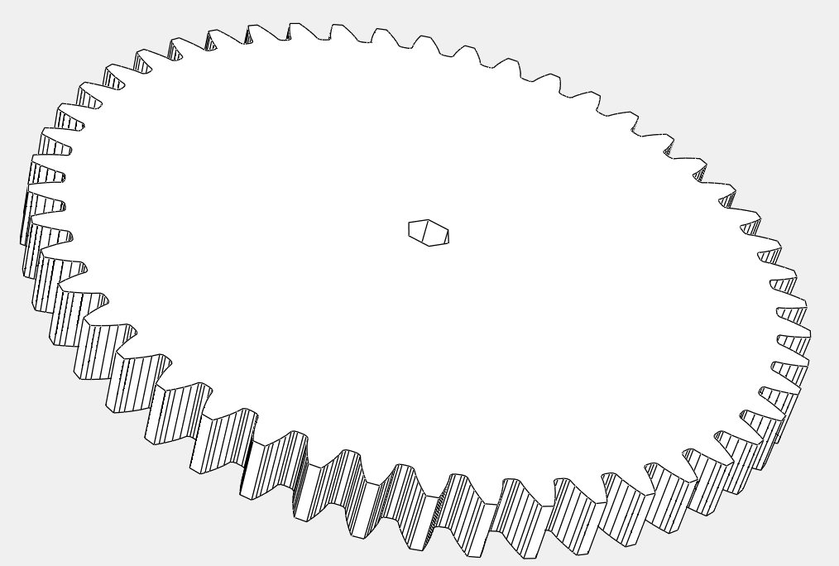
Brush Gear

Slide 26
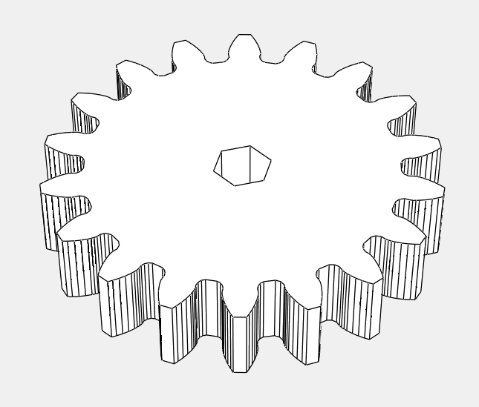
Transition Gear from Motor to Brush (this mounts onto the center of a brush)

Slide 27
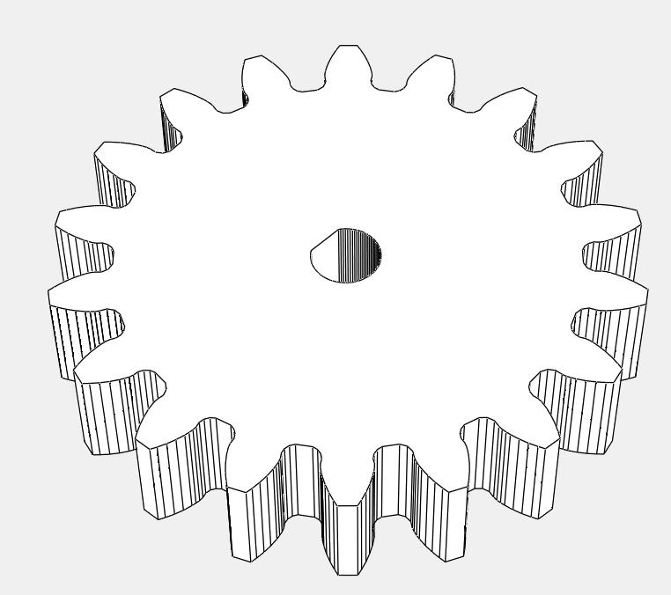
DC Motor Shaft Gear (this mount onto the DC motor shaft and connects to the gear above)

Slide 28
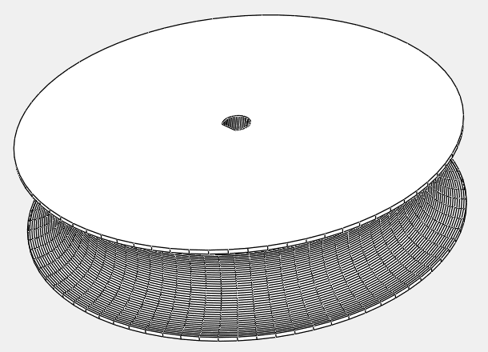
Pully(attaches directly to the stepper motor)

